Slide 1
LexiEaseAI - An AI Powered Dyslexic Support System
Team Members: Siddhartha Chakrabarty
Sneha Jain

Slide 2
Problem Statement
This gap hinders the ability of dyslexic individuals to fully engage in academic and professional environments, impacting their confidence and overall quality of life.
Dyslexia is a common learning difficulty affecting individuals' ability to read, write, and spell, often leading to challenges in education, employment, and daily life.
Existing solutions often lack adaptability to varying levels of dyslexia severity, fail to provide real-time assistance, and personalized support system.

Slide 3
Why Did We Choose This Problem Statement
The objective of this project is to develop an AI-powered support system that assists dyslexic individuals in improving their reading, writing, and comprehension skills.
Leveraging NLP, speech recognition, and text-to-speech technologies, the system will offer real-time, personalized assistance to make written content more accessible and improve the learning experience.
The goal is to empower dyslexic users to engage with text more effectively, boost their academic performance, and build confidence in their language abilities.

Slide 4
Our Solution
Three Dyslexic Tests
Phonological Awareness Test
Gray Oral Reading Test
Kauffman Assessment Battery Test

Slide 5
Our Solution
Personalized Learning Paths
Reading comprehensions
Memory Games
Reading passages
Reading passages
Reading comprehensions
Phonological Improvement Assistant
Severe
Mild
Moderate
Reading passages
Reading comprehensions
Memory Games

Slide 6
Our Solution
Document Simplification
Writing Support
Notes & Mind Map Generation

Slide 7
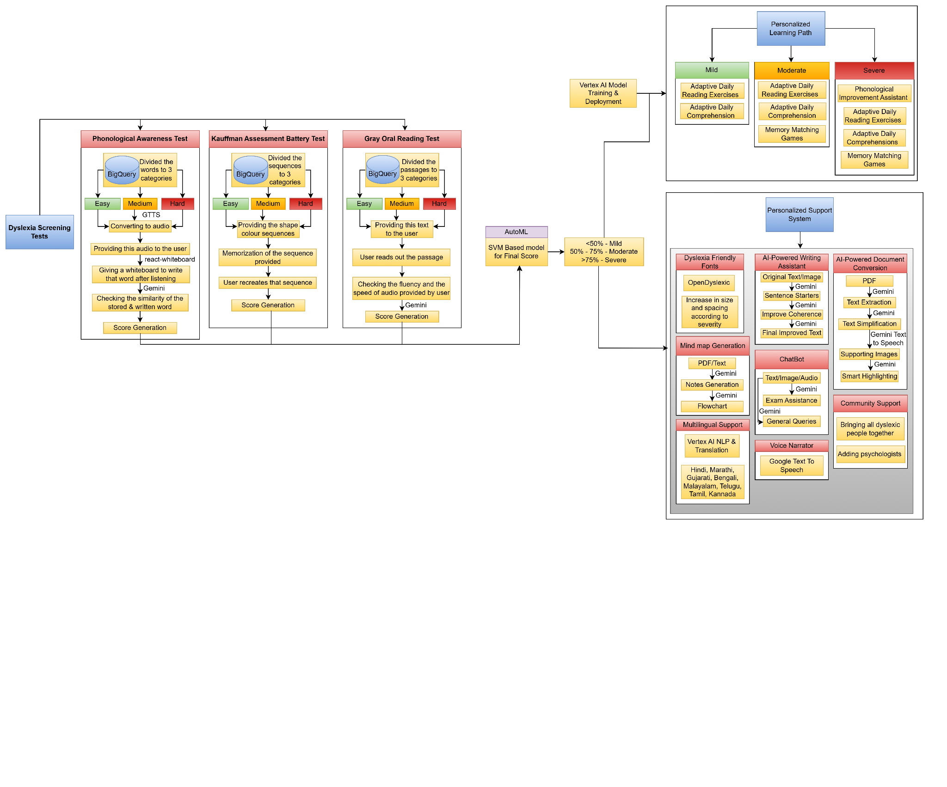
SYSTEM ARCHITECTURE

Slide 8
How Did We Use Vultr’s Infrastructure
Vultr Services | How did we use them?
Vultr Compute Instance | Deployed the Frontend & Backend on Vultr Compute Instances
Vultr Block Storage | Utilized Vultr Block Storage to store files and images.
Vultr Managed SQL Database | Utilized Vultr Managed SQL Database to act as the primary database for the entire website.

Slide 9
Future Scope
Making the entire solution multilingual to make it more accessible for people fluent in other languages.
Increase the database of the dyslexia screening tests as well as the games to make it more extensive.

Slide 10
Thanks!

